Slide 1
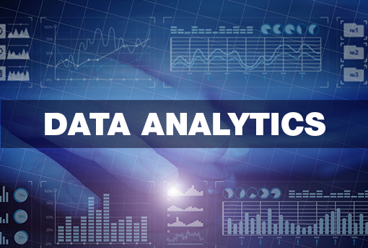

Slide 2
What is Data?
Data is a different types of information formatted in a particular manner or Data is a collection of information present in the form of History, Past records or Present records.
Data can come in the form of text, picture, numbers, graphs and symbols.
What is Data Analytics?
Data Analytics is the process of collection, transformation and organizing the data in order to draw conclusions, make predictions and to boost data driven decision making.

Slide 3
Applications of Data Analytics
Data Analytics is used in the banking and e-commerce industries to detect fraudulent transactions.
The Healthcare sectors uses data analytics to improve patients health by detecting diseases before they happen. It is commonly used for cancer detection.
Logistics companies use data analytics to ensure faster delivery of products by optimizing vehicle routes.
Marketing professionals use analytics to reach out to the right customers and perform targeted marketing to increase ROI.
Data analytics can be used for city planning, to build smart cities.

Slide 4
Super Store Sales Data Analysis
Let me Explain how data analyst works in a real-world industry by taking example of Super Store Sales Data Analysis Project.
Steps Followed in Data analysis Process
Problem statement
Data Collection
Data Cleaning
EDA process
Creating Dashboard
Conclusion

Slide 5
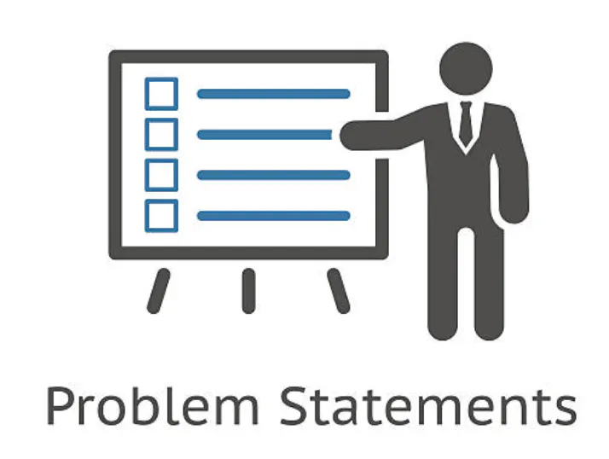
Step 1: Problem Statement
To contribute to the success of a business by utilizing data analysis techiniques, specifically focusing on time series analysis , to provide valuable insights andaccurate
Sale forecasting.

Slide 6
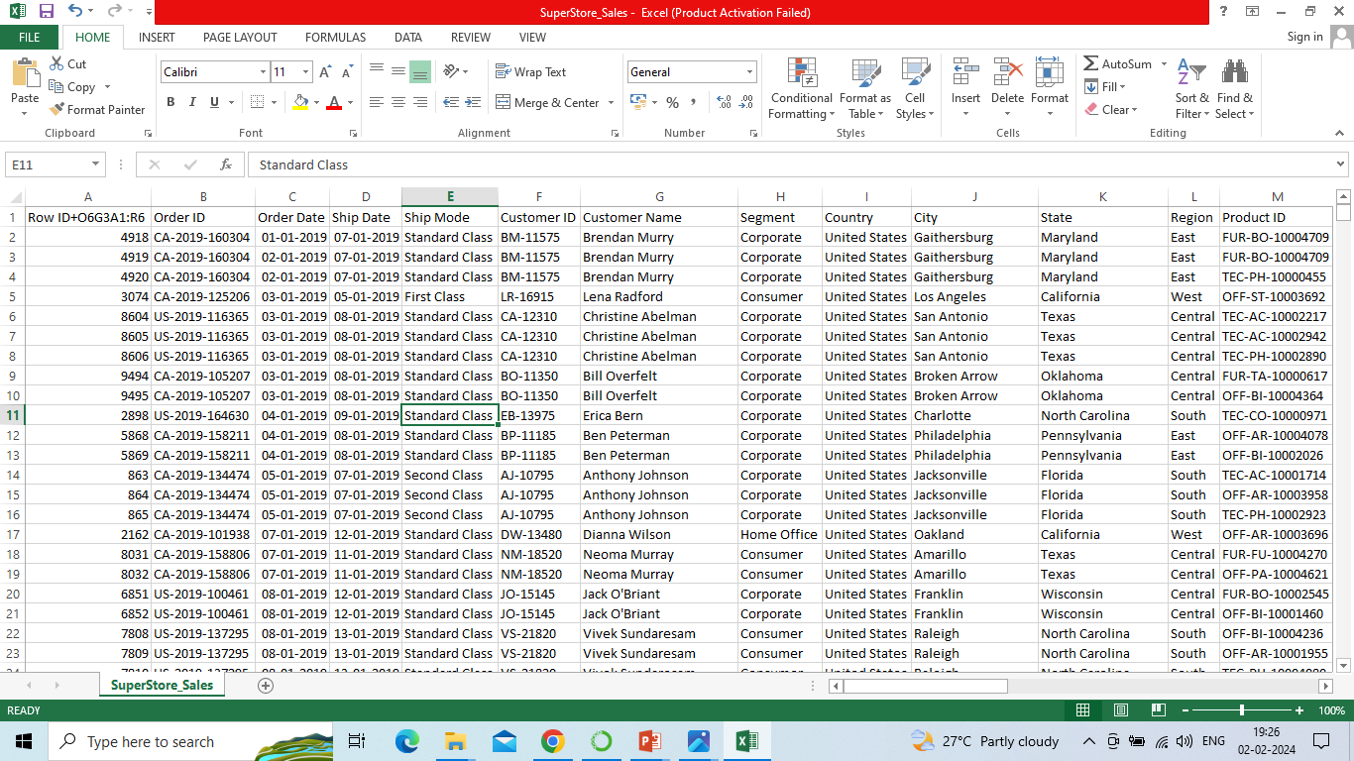
5901
Step 2: Data Collection
Data Size: 1.0+ MB
Collection of measurements:
Total No. of Columns: 23
Total No. of Rows: 5901
Data Format: Store Sales Data.csv
Column Names:
NumericalData/Columns:Row ID,Sales,Quantity,Profit,Returns

Slide 7
Categorical Data/Columns: Order Date, Ship Date, Ship Mode,Customer ID, Customer Name, Segment, Country, City,State, Region,Product ID, Category, Sub-Category, Product Name, Payment Mode

Slide 8
ind1 0 non-null float64 22 ind2
ind1 0 non-null float64 22 ind2
Step 3: Data Cleaning
Data cleaning process is done by using ETL (Extract, Transform, Load) technique.
Extract: Extract the data from file in csv, sql format of file.
Transform: Transform is nothing but modify or change the data. In this step we clean all the data, to find missing values and filled them using python libraries. So new values are added to the existed raw data and to make it clean.
Load: Load or upload the cleaned data into database.
Data is transformed (cleaned) in Power BI query editor.
We got the data set almost cleaned,some duplicate values and it was removed by using power bi query editor.
Ind1 and ind2 empty columns are removed.

Slide 9
Step 4: EDA ( Exploratory Data Analysis)
EDA technique is used to analyze cleaned data to draw informative insights.
Identifythe KPIs,design an intuitive and visually appealing dashboard, add interactive visualizations and filtering capabilities to allow users to explore the data at various levels of granularity.
Provided valuable insights to business entities regarding the effectiveness of their sales strategies through visualization and charts.
Leverage historic data and apply time series generate sales forecasts for next 15 days.

Slide 10
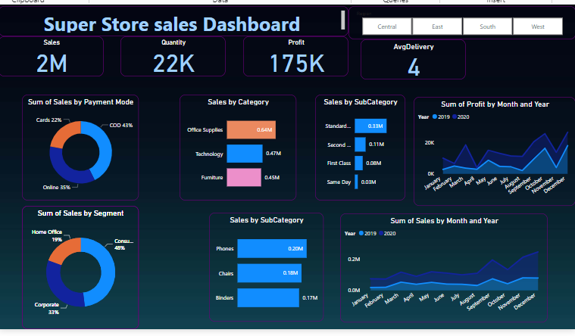
Step 5: Creating Dashboard
To create Dashboard, different types of charts are used in the Super Store Sales data analysis dashboard creation.

Slide 11
Conclusion:
Highest sales done in September to December , highest profit got in October and December months. Highest Payments are done in cash on delivery and lowest payment are done by cards. To improve sales provide offers/coupons who are paying through cards.

